Slide 1
The 2012 2013 Farm Bill
2013 Land Values Conference
ISPFMRA
Nick Paulson
npaulson@illinois.edu
University of Illinois

Slide 2
Where to From Here? (Ending slide from last year)
Will now move through a more “standard” Farm Bill process
Senate and House Ag Committees write own bills
House budget outline two days ago
Stabenow has goal of Memorial day for Senate
Will extend well into 2012, maybe even 2013
While existing proposals provide some guidance, speculation remains
Still many questions for commodity program modifications and beyond
Regional battles for baseline

Slide 3
Where to From Here? (Ending slide from last year)
Will now move through a more “standard” Farm Bill process
Senate and House Ag Committees write own bills
House budget outline two days ago
Stabenow has goal of Memorial day for Senate
Will extend well into 2012, maybe even 2013
While existing proposals provide some guidance, speculation remains
Still many questions for commodity program modifications and beyond
Regional battles for baseline

Slide 4
2013 Farm Bill - Timeline
June 21, 2012: Senate passes Farm Bill
July 12, 2012: House Ag Committee passes Farm Bill
Fall 2012: Fiscal cliff, 2008 Farm Bill extended through September 2013
March 1, 2013: Sequester
$85 billion in cuts in FY 2013, $1.2 trillion over next 10 years
March 27, 2013: Potential gov’t shutdown

Slide 5
2013 Farm Bill - Issues
Primary
Budget
Deficit Reduction
Secondary
Record farm incomes
USDA programs viewed as wasteful
Political battles and PR issues

Slide 6
2013 Farm Bill
General theme of Current Bills:
Income Support is Out; Risk Management is In
Existing commodity programs replaced by something new
Continued support for crop insurance
Cuts to:
Commodity programs
Nutrition programs
Conservation programs

Slide 7
FY 2013 Projected USDA Budget

Slide 8
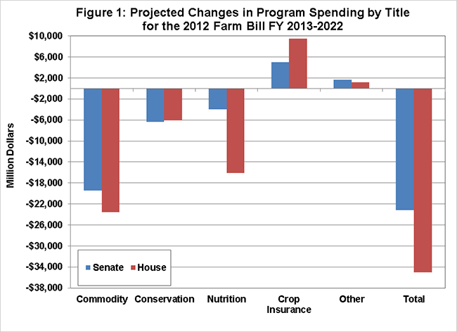
2012 CBO Score of Farm Bills

Slide 9
Spending Cuts Comparison
 | Senate | House
Commodity Programs | (30%) | (38%)
Conservation | (9.4%) | (9.4%)
Nutrition | (0.5%) | (2.1%)
Crop Insurance | +5.5% | +9.9%

Slide 10
2013 CBO Updated Score
Senate Farm Bill (S. 3240)
$13.1 billions in total savings, or ~$10 billion in reduced savings
$3.8 billion from commodity programs
$1.4 billion from conservation
$4.4 billion from nutrition

Slide 11
2013 CBO Updated Score
House Ag Committee (H.R. 6083)
$26.6 billion in total savings, or ~$8.5 billion in reduced savings
$1.1 billion from commodity programs
$1.7 billion from conservation
$4.3 billion from nutrition
$1.7 billion in crop insurance

Slide 12
Changes to Commodity Programs, Crop Insurance
Eliminate Direct Payments, CCP, ACRE, and SURE
Revenue and price programs that pay out on planted acres:
Senate Bill: Choice between farm and county level ARC program
House Bill: Choice between county level RLC program and PLC program
Supplemental insurance coverage (SCO)
Area insurance (STAX) for Cotton

Slide 13
Ag Risk Coverage (ARC)
ARC is the Senate Bill’s revenue program
Choice between farm- and county-level coverage
Guarantee based on Olympic average of yields and prices
Payments made when actual revenues fall below 89% of the guarantee, capped at 10% of the guarantee

Slide 14
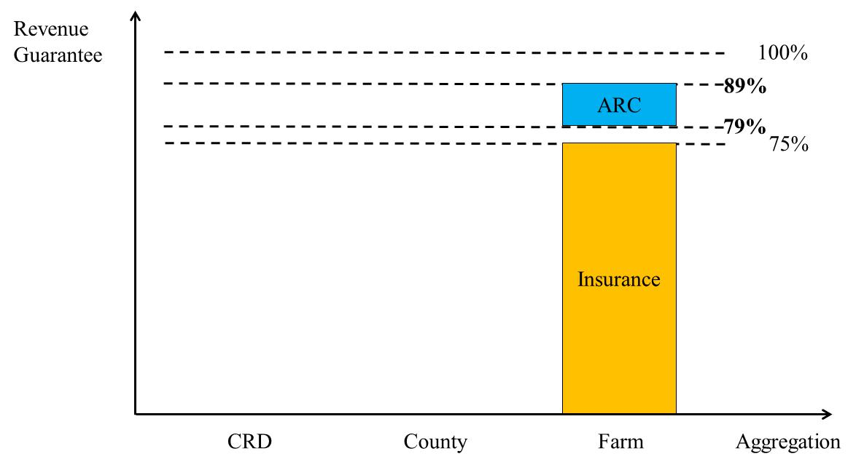
Farm-level Ag Risk Coverage (ARC)

Slide 15
Revenue Loss Coverage (RLC)
RLC is the House Bill’s revenue program option
Choice between RLC and PLC
Guarantee based on Olympic average of yields and prices
Payments made when actual revenues fall below 85% of the guarantee, capped at 10% of the guarantee

Slide 16
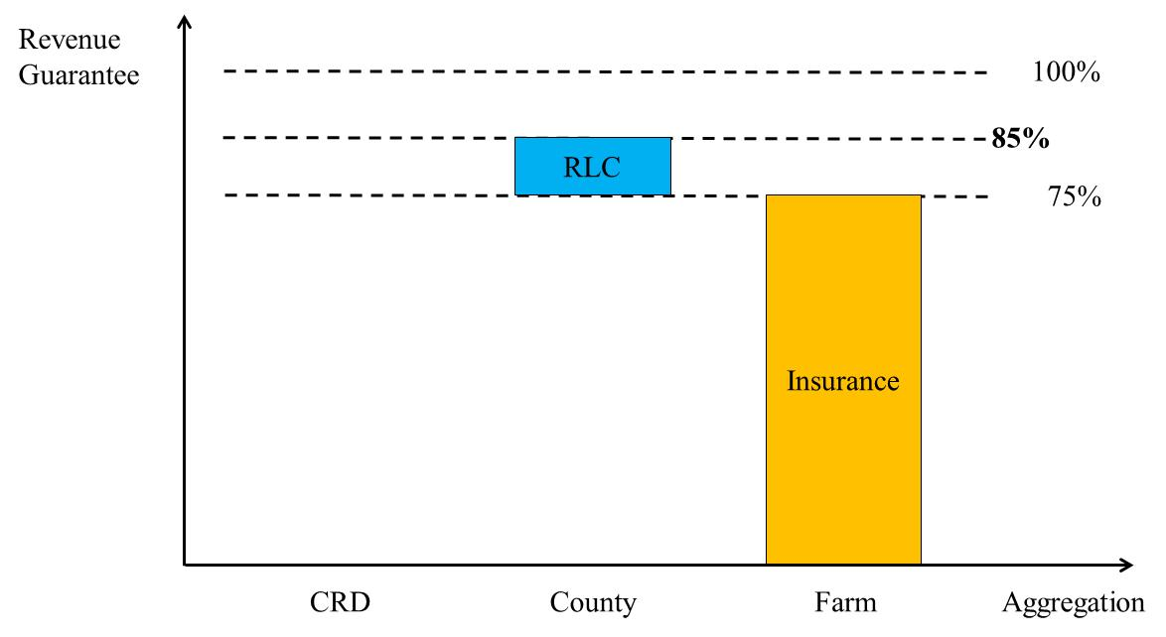
Revenue Loss Coverage (RLC)

Slide 17
Price Loss Coverage (PLC)
PLC is similar in concept to current CCP program; also default program in House Bill
Paid on planted acres (rather than base); cannot receive payments on more than total base acres
May update payment yields to 90% of 2008 to 2012 average by crop

Slide 18
Price Loss Coverage (PLC)
Crop | Loan Rate | Reference Price
Corn ($/bu) | $1.95 | $3.70
Soybeans ($/bu) | $5.00 | $8.40
Wheat ($/bu) | $2.94 | $5.50
Cotton ($/lb) | $0.47-$0.52 | $0.6861*
Rice ($/hwt) | $6.50 | $14.00
Peanuts ($/lb) | $0.18 | $0.27

Slide 19
Supplemental Coverage Option (SCO)
SCO is an optional, supplemental insurance program
County-level coverage
Defined by individual insurance program choice
Covers losses between 90% of the guarantee and individual insurance coverage
Premium subsidy rate of 70%

Slide 20
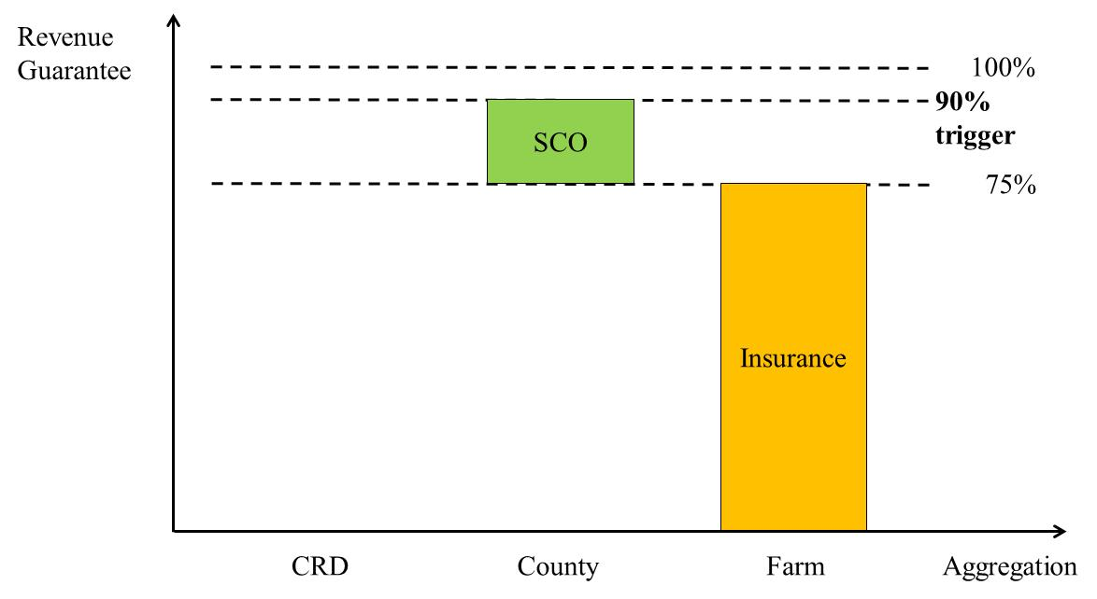
Supplemental Coverage Option (SCO)

Slide 21
Proposed Program Comparisons
 | SENATE | HOUSE |  | BOTH
 | ARC | RLC | PLC | SCO
Payment Rate | Farm: 65% (45%) County: 80% (45%) | 85% (30%) | 85% (30%) | 100%
Payment Limit | $50,000 per entity | $125,000 per entity | $125,000 per entity | None
Eligible for SCO? | Yes | No | Yes | -
Subsidy | Full | Full | Full | 70%

Slide 22
Summary Points
Shift towards risk management focused programs
Choice among program options
Revenue, possibly price protection
Links between proposed commodity programs, current and proposed crop insurance programs
Crop insurance main safety net for crop producers

Slide 23
Now What?
2013 CBO updated scores imply reduced savings for current proposals
May require major changes
Sequester requires ~5% cut to USDA programs in FY 2013
Could be allocated differently across programs
Could impact 2013 Direct Payments
Will not impact crop insurance payments
No action likely until at least April

Slide 24
Questions?
npaulson@illinois.edu
www.farmdoc.illinois.edu
www.farmdocdaily.illinois.edu

