Slide 1
CROP INSURANCE 101

Slide 2
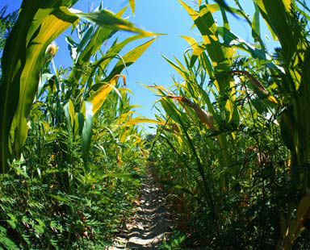
Common Crop Insurance Policy
Individual Plans
Yield Protection (YP): Yield loss protection at spring price
Revenue Protection (RP): Yield and revenue loss protection at higher of spring or harvest price
Revenue Protection with Harvest Price Exclusion (RPE): Revenue loss protection at spring price
Uses farm APH (Actual Production History) – this is your farm(s) yield history
Levels of coverage: 50% to 85% in 5% increments
Unit Structure: Basic, Optional, or Enterprise
Includes Replant and Prevented Planting coverage
Spring Price:
-Corn: Average December futures closing price during February
-Soybeans: Average November futures closing price during February.
Harvest Price:
-Corn: Average December futures closing price during October
-Soybeans: Average November futures closing price during October

Slide 3
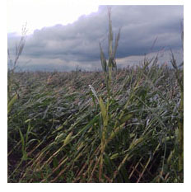
Yield Protection (YP)
Yield protection (YP) protects against loss of yield on your farm operation. Your guarantee is based on your APH yield, spring price, and level of coverage. If your actual yield is less than your selected guarantee, you are paid for loss of yield at the spring price.
YP Corn Example:
APH yield = 180 bu / acre
Spring Price = $6.00 / bu
Level of coverage = 85%
Bushel guarantee = 153bu / ac
(180 bu / ac APH x 85%
coverage)
2013 harvested bushels = 130 bu / ac
Loss payment: 153 bu / ac guarantee – 130 bu / ac harvested = 23 bu / ac loss
23 bu / ac loss x $6.00 / bu = $138.00 / ac indemnity payment

Slide 4
Revenue Protection (RP)
RP protects you from the following:
If the farm produces less bushels than guaranteed
If the farm produces less revenue than guaranteed
Revenue Protection (RP) protects you from a loss of yield and price movement from planting to harvest. In addition to a yield guarantee, RP also provides a revenue guarantee. The revenue guarantee is based on your APH, higher of spring price or harvest price, and level of coverage. Your harvested revenue is based on harvested bushels x harvest price.
RP Corn Example 1: (bushel loss, price increase)
APH = 180 bu / acre
Spring Price = $6.00 / bu
Harvest Price = $7.25 / bu
Level of coverage = 85%
2013 harvested bushels = 130 bu / ac
Harvest Price: $7.25 / bu (note price increase)
New Harvest Guarantee: $1109 / ac (153 bu / ac APH x $7.25 harvest price)
Harvest revenue: $943 / ac (130 bu / ac harvested bushels x $7.25/ bu harvest price)
Loss payment: $1109 / ac guarantee - $943.00 actual = $166 / ac indemnity payment
-Bushel guarantee = 153 bu / ac
(180 bu /ac APH x 85% coverage)
-Spring Revenue guarantee = $918.00 / ac
(153 bu /ac APH x $6.00 / bu spring price)
RP Corn Example 2: (no bushel loss, price decrease)
APH = 180 bu / acre
Spring Price = $6.00 / bu
Harvest Price = $4.50 / bu
Level of coverage = 85%
Bushel guarantee = 153 bu / ac (180 bu / ac APH x 85% coverage)
Spring Revenue guarantee = $918.00 / ac (153 bu /ac APH x $6.00 / bu spring price)
2013 harvested bushels = 180 bu / ac
Harvest Price: $4.50 / bu (note price decrease)
Harvest Guarantee: $918.00 / ac (153 bu / ac APH x $6.00 / bu spring price)
Harvest revenue: $810.00 / ac (180 bu / ac harvested bushels x $4.50/ bu harvest price)
Loss payment: $918.00 / ac guarantee - $810.00 actual = $108 / ac indemnity payment

Slide 5
Revenue Protection with Harvest Price Exclusion (RPE)
Revenue Protection with Harvest Price Exclusion (RPE) provides the same initial revenue guarantee as RP. This revenue guarantee is based on the spring price ONLY, so as a fixed revenue guarantee, when the harvest price goes higher, less bushels are protected. NO BUSHEL GUARANTEE.
RPE Corn Example 1: (bushel loss, price increase)
APH = 180 bu / acre
Spring Price = $6.00 / bu
Harvest Price = $7.25 / bu
Level of coverage = 85%
Revenue guarantee = $918.00 / ac (180 bu /ac APH x $6.00 / bu spring price x 85% level)
2013 harvested bushels = 130 bu / ac
Harvest Price: $7.25 / bu (note price increase)
Harvest revenue: $943.00 / ac (130 bu / ac harvested bushels x $7.25 / bu harvest price)
Loss payment: $918 / ac guarantee - $943.00 actual = NO PAYMENT
(Regular RP paid $166 / AC in this same example)
RPE Corn Example 2: (no bushel loss, price decrease)
APH = 180 bu / acre
Spring Price = $6.00 / bu
Harvest Price = $4.50 / bu
Level of coverage = 85%
Bushel guarantee = 153bu / ac
Revenue guarantee = $918.00 / ac (180 bu /ac APH x $6.00 / bu spring price x 85% level)
2013 harvested bushels = 180 bu / ac
Harvest Price: $4.50 / bu (note price decrease)
Harvest revenue: $810.00 / ac (180 bu / ac harvested bushels x $4.50/ bu harvest price)
Loss payment: $918.00 / ac guarantee - $810.00 actual = $108 / ac indemnity payment

Slide 6
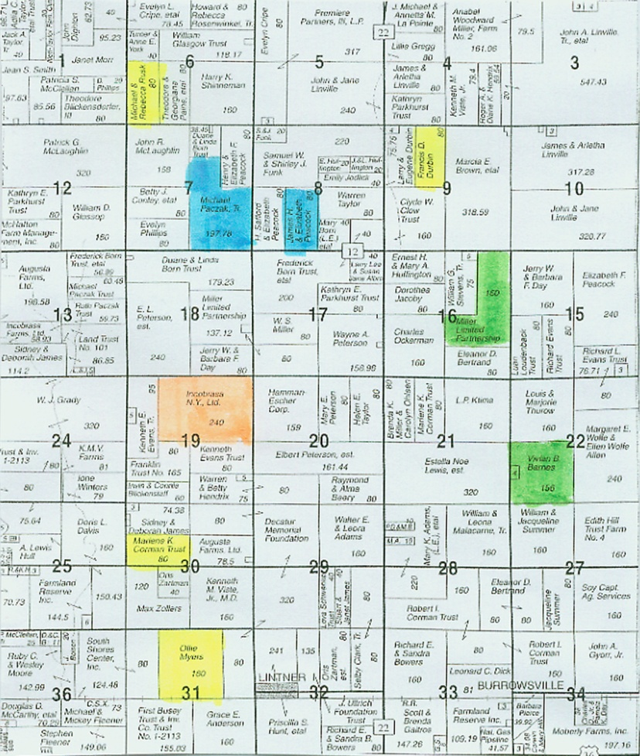
Unit Structure
Individual crop insurance plans divide your acres into insurable units. Unit structure type is a decision to make when putting together your crop insurance plan. (Note: Each county / crop is insured separately.)
Basic Units: Cropland with same SHARE parties is a separate unit (ex: all 100% is one unit, each 50/50 landlord is a unit).
Optional Units: Basic units can be split into more units by section, with good records.
Enterprise Unit: each CROP per county is a unit. (ex: all corn in Champaign Co. is a unit). Most discounted premium.
Enterprise Unit Qualifications:
Must have insured crop in 2 or more sections, FSN’s, or section equivalents
At least 2 of the sections / FSN’s must have planted acres that equal the lesser of 20 acres or 20% of the total enterprise unit
Sections / FSN’s can be combined in order to meet this 20/20 rule Ex: 80 acres in section 1, 10 acres in section 2, 10 acres in section 3
Cash rent / Own
50/50 Landlord #1
50/50 Landlord #2
50/50 Landlord #3

Slide 7
A supplemental policy offered by Farm Credit through ADM Crop Risk Services and Great American Insurance that can be added to an Enterprise Unit Multi-Peril Policy.
Enterprise Units combine all farmed acres of a single crop within a county into one unit. The Enterprise Plus supplemental policy works like an Optional Unit policy, and allows for different guarantees for each individual unit.
E+ can be added to YP, RP or RPE policies.
Qualifies for an Enterprise Unit policy with up to 10 “optional or basic” sub units within it (NEW FOR 2013)
If you whole crop with EU is not generating a loss payment and one or more of the smaller units within would have a loss, then a claim is triggered.
E Plus - Levels of Coverage
RP or RP-HPE | 85% | 80% | 75%
80% | Yes | No | No
75% | Yes | Yes | No
70% | Yes | Yes | Yes
EP+
EP+
EP+
If a loss payment is triggered on the EU policy, regardless of amount, Enterprise Plus will not Pay
If more than 10 basic units, it does not qualify.
High risk land does not qualify
Land under written agreements not allowed
Must also qualify for the new Trend Adjusted APH (minimal actual yield history on at least one unit)
Most of our EU policies will qualify

Slide 8
Group Risk Plan (GRP)
GRP is a yield only protection policy. It uses an expected market price and the expected county yield to determine your maximum protection / acre. There is no price protection built into this program.
GRP breakdown:
Based on expected county yield (determined by National Agricultural Statistical Service)
Levels of coverage: 70% to 90% in 5% increments
Expected market price: set by Federal Crop Insurance Corporation (FCIC). Not the same as price used for RP or GRIP.
Maximum protection / acre: Expected county yield x expected market price x 1.5
Loss occurs if the current crop year’s county yield (announced the following April 1st) falls below the expected yield x level.
No replant or prevented planting coverage. No guarantee for your farm. Your yield may be better or worse than the county.
GRP example:
Expected county yield = 177.4 bu / acre
Expected market price = $5.50 / bu
Level of coverage = 90%
Price Election = 100%
Trigger yield = 159.66 bu /acre (90% of 177.4 Bushel/acre expected)
Maximum Protection = $1463.55 / acre (177.4 x $5.50 x 1.5)
2013 county yield average = 140 bu /acre
Loss payment: 159.66 – 140 = 19.66 short / 159.66= 12.3 % loss
$1463.55 maximum protection / ac x 12.3% loss = $180.00 / ac indemnity payment

Slide 9
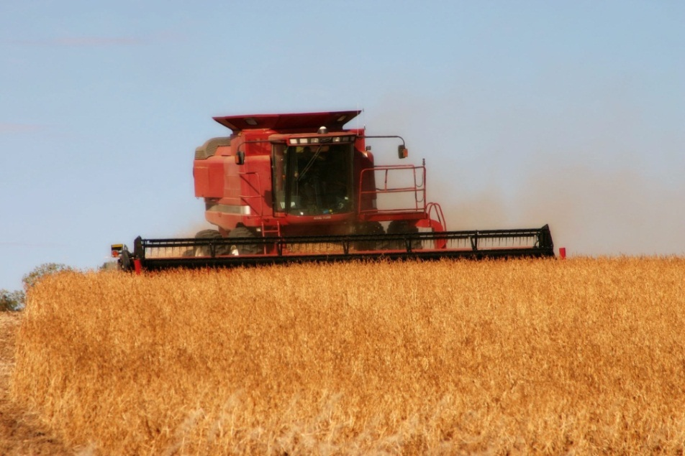
Group Risk Income Protection (GRIP)
GRIP is a revenue based policy. It uses expected county yield like GRP but only uses spring price like the RPE program. In order to use the higher of the two for your guarantee you must select the Harvest Revenue Option (GRIP-HRO).
Based on expected county yield (determined by National Agricultural Statistical Service) and spring price.
Levels of coverage: 70% to 90% in 5% increments
Price Level: 60% - 100% taken at 1% increments
Trigger revenue: Expected county yield x spring price x coverage level. With HRO added, Trigger revenue uses higher of spring or harvest price. In 2012, trigger revenue for GRIP HRO are also higher than regular GRIP.
Maximum protection / acre: Expected county yield x spring price (or higher of spring / harvest w/ HRO) x 1.5 factor x price election (60% to 100%).
Loss occurs if the current crop year’s county yield average x harvest price falls under your trigger revenue.
No replant or preventive planting coverage.
No individual farm guarantee
Indemnity payments can be very large in a year like 2012 but annual premiums for GRIP HRO are high.

Slide 10
Group Risk Income Protection (GRIP and GRIP/HRO)
GRIP and GRIP/HRO 90-100 CORN Example:
2013 Expected County Yield: 177.4 Bushel/Acre Spring Price: $6.00
Max. Protection/acre GRIP = 177.4 x $6 x 1.5 = $1,596.60
Fall Price: $4.50 (Spring price higher so both use that)
Actual Harvest yield = 175 Bushel/Acre for county Actual Rev = $787.5
Loss Calculation (when price falls at harvest).
Expected County Yield x Level x Spring Price = GRIP Trigger Revenue
(177.4 Bushel/Acre x 90 % x $6.00 = $958.00 per acre)
GRIP Trigger Revenue less Actual Revenue = $170.50 short
$170.50 / $958.00 = 17.8% shortfall
17.8% x $1,596.60 (Max Protection/Acre) = $284.20 per acre loss.
(price lower, so GRIP and GRIP/HRO pay the same
GRIP and GRIP/HRO 90-100 CORN Example:
2013 Expected County Yield: 177.4 Bushel / ac Spring Price: $6.00
Maximum Protection / Acre GRIP = 177.4 x $6 x 1.5 = $1596.60
Fall Price: $7.25
Maximum Protection / Acre GRIP/HRO = 177.4 x $7.25 x 1.5 = $1929.23
Actual Harvest yield = 140 bushel/acre for county Actual Revenue = $1015
Loss Calculation (when price increases at Harvest).
Expected County Yield x Level x Spring Price = GRIP Trigger
(177.4 Bushel/Acre x 90 % x $6.00 = $958.00 per Acre)
Expected County Yield x Level x Harvest Price = GRIP/HRO Trigger
(177.4 Bushel/Acre x 90 % x $7.25 = $1157.54/Acre)
Regular GRIP Trigger Revenue less Actual Revenue
$958 minus $1015 actual = NO LOSS PAID
GRIP/HRO Trigger Revenue less Actual Revenue
$1157.54 - $1015 = $142.35 short
Shortfall - $142.35 / $1157.54 = 12.3%
12.3% x $1929.23 Maximum Protection = $237.30 Loss

Slide 11
NEW for 2013 – HR-ACE
The HR-ACE (High Risk Alternative Coverage Endorsement) allows policyholders to insure high-risk acres at an additional coverage level that is lower than the coverage level on their non-high-risk acres (as an optional endorsement to a Federal reinsured additional corn, soybean, wheat, or grain sorghum policy.)
Qualifications:
A producer with ground in high risk areas who insure their non-high risk ground with YP, RP, RPE.
Yield and Revenue Protection available depending on the base plan.
The base policy may have OU, BU, or EU, however HR-ACE unit structure must be OU or BU.
* The preceding High-Risk Land Exclusion option only allows an insured to elect to not insure high-risk acres, or to insure them at the catastrophic level of coverage.
With YP, HR-ACE levels must be lower than the base coverage level.
With RP/RPE, HR-ACE levels using RP must be lower than the base coverage level, but if YP is the HR-ACE coverage, the levels can be the same or less.
Base Plan | HR ACE Options
85 YP |  | 80 YP | 75 YP | 70 YP | 65 and lower YP
85 RP | 85 YP | 80 YP | 75 YP | 70 YP | 65 and lower YP
85 RP |  | 80RP | 75 RP | 70 RP | 65 RP and lower
HR-ACE includes the same Replant and Prevented Planting coverage as the base policy.
Added land rules apply to the HR-ACE acres. (Yield is based on simple average of existing high risk ground.)
Premium for HR-ACE coverage is the same as existing high risk land rates.
CAT coverage with a High Risk Land Exclusion is still available

Slide 12
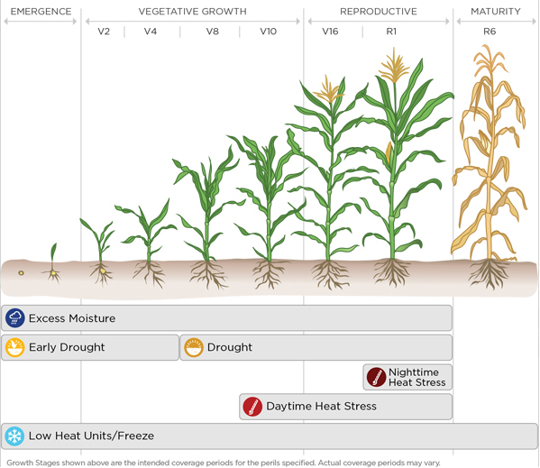
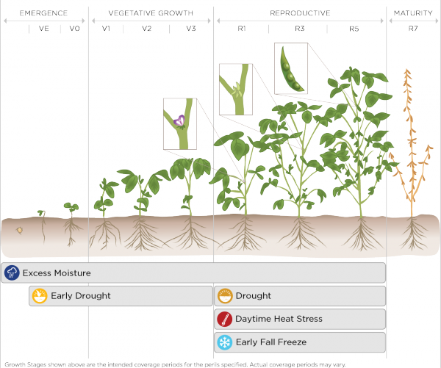
Total Weather Insurance
(TWI)
Establishes criteria for individual policies within a 2.5 mile x 2.5 mile grid using National Weather Service information, soil types and Doppler Radar.
Pays when measurable rain and temperatures breach defined levels which would adversely affect optimum yields.
Corn
Soybeans

Slide 13
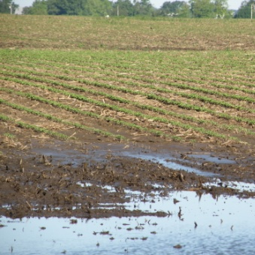
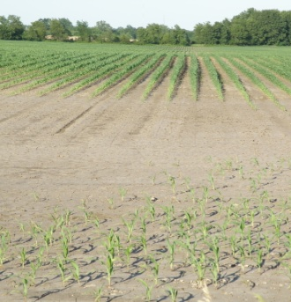
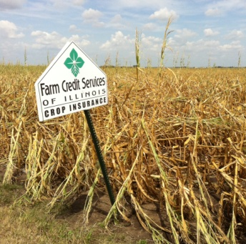
Total Weather Insurance
(TWI)
Perils
Excess Moisture – entire growing season
Early Season Drought / Growing Season Drought with Soil Moisture Tracker
Considers soil type, rainfall, temp, plant use, relative maturity
Daytime Heat Stress / Nighttime Heat Stress
Low Heat Units (Corn) - Early Fall Freeze (Soybeans)
Premium
Instead of each peril having an effective deductible, there is one combined $ deductible for the policy.
Claims paid as follows
Deductible → Premium → Available amount of coverage
Premium increases as we approach March 15th deadline.
Can lower acres or cancel by March 15th with no penalty or fees.
TWI can be purchased on less than 100% of acres farmed
TWI must be purchased before MP deadline of March 15th
No adjusters are involved – weather information from NWS determines if a loss payment should be issued.

Slide 14
Crop Hail Insurance
Hail insurance provides protection for the following:
Hail
Fire and Lightning
Vandalism
Transit (while being hauled)
Stored Grain (while in storage)
Catastrophic Loss
These perils can also be added to a hail policy:
Green Snap
Wind
Extra Harvest Expense
Replant / Preventive Planting for GRIP / GRP policies
Stand alone policy: Written only on crops and fields you want hail insurance on. Renewal date is June 1 for that crop year.
Auto –Hail: Hail policy tied in with your Multi-Peril Crop Insurance. You pick the amount of coverage you want per crop, per county and it is applied to all of your crops covered on your Multi-Peril policy (recommended).
Hail insurance is very reasonably priced and makes a great addition to your risk management package for little additional cost.

Slide 15
MPCI Causes of Loss
Insurance is provided against only the following causes of loss which occur within the insured period:
Adverse weather conditions
Fire, only if caused by lightning
Insects, but not damage due to insufficient or improper application of pest control measures
Plant disease, but not damage due to insufficient or improper application of disease control measures
Wildlife
Earthquake
Volcanic eruption
Failure of the irrigation water supply, if applicable, due to an unavoidable cause of loss occurring within the insurance period.
Causes of Loss NOT Covered
Negligence, mismanagement, or wrongdoing by you, any member of your family or household, your tenants, or employees
Failure to follow recognized good farming practices for the insured crop
Water contained by any governmental, public, or private dam or reservoir project
Failure or breakdown of irrigation equipment or facilities
Failure to carry out a good irrigation practice for the insured crop, if applicable
Chemical damage

Slide 16
Notice of Loss
Crop Damages must be reported within 72 hours of discovery of damage but no later than 15 days after the end of insurance period (December 10 for spring crops).
Call before destroying crop
Leave representative strips
Prevented Planting: you must notify us within 72 hours after final plant date or late plant period, if unable to plant
Report Prevented Corn by 6-30
Report Prevented Soybeans by 7-15
Late Planting
Bushel Guarantee for Late Planted Acreage Reduced By:
Timely Planted
Corn: June 5th
Soybeans: June 20th
Grain Sorghum: June 20th
Late Planted
Corn: June 6th – June 30th
Soybeans: June 21st – July 15th
Grain Sorghum: June 21st – July 15th
Late planted crops (after 6-30 or 7-15) receive a 1% bushel guarantee decrease for every day the crop is not planted in the 25 day late planting period.
Prevented planting guarantee is 60% or 70% of the crop’s bushel guarantee.

Slide 17
Replant Benefit from MPCI Plans
RP, RPE, YP all provide replant reimbursements on qualifying acres.
Insured must file Replant claim BEFORE the field is replanted – Company must approve.
**Estimate from 2012 Spring Prices**
CORN | 8 Bu. X $5.68 = $45.44 Per Acre
SOYBEANS | 3 Bu. X $12.55 = $37.65 Per Acre
GRAIN SORGHUM | 8 Bu. X $5.53 = $44.24 Per Acre
20/20 Rule:
Acreage must be the lesser of 20 acres or 20% of the acreage in unit to qualify for replant payment.

Slide 18
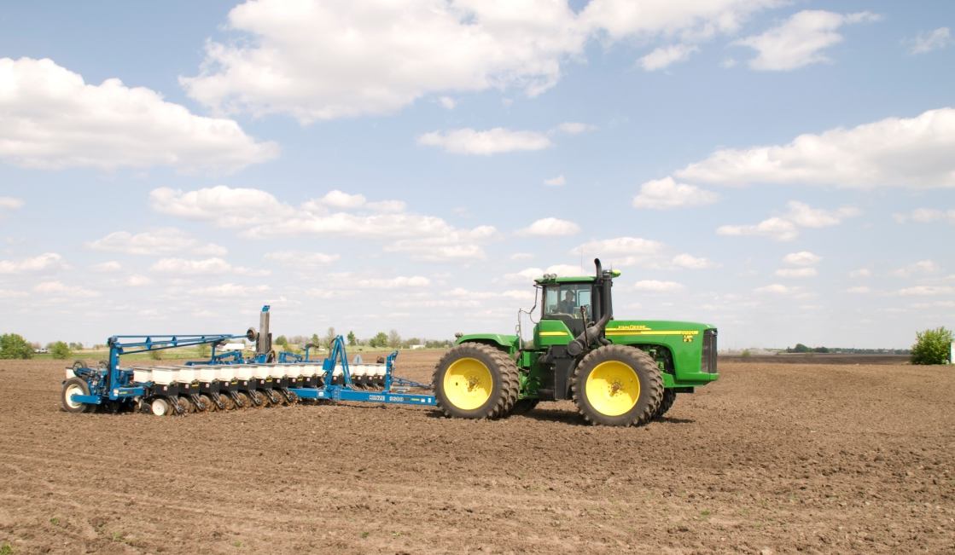
Prevented Planting
Protection when weather prevents timely planting.
Idle acreage will earn a 60% or 70% payment (buy up to 70% available) of per acre guarantee X price.
Acreage must be lesser of 20 acres or 20% of acreage in unit. PP acres don’t have to be contiguous.
Avoid splitting PP acres and planted acres in same unit, unless crop history indicates two crops in field in the last four years.
Eligible PP acres determined by maximum number of acres of that crop, raised in the past FOUR years (exception- double crop soybeans).
Prevented planting not limited to TWO consecutive years.

Slide 19
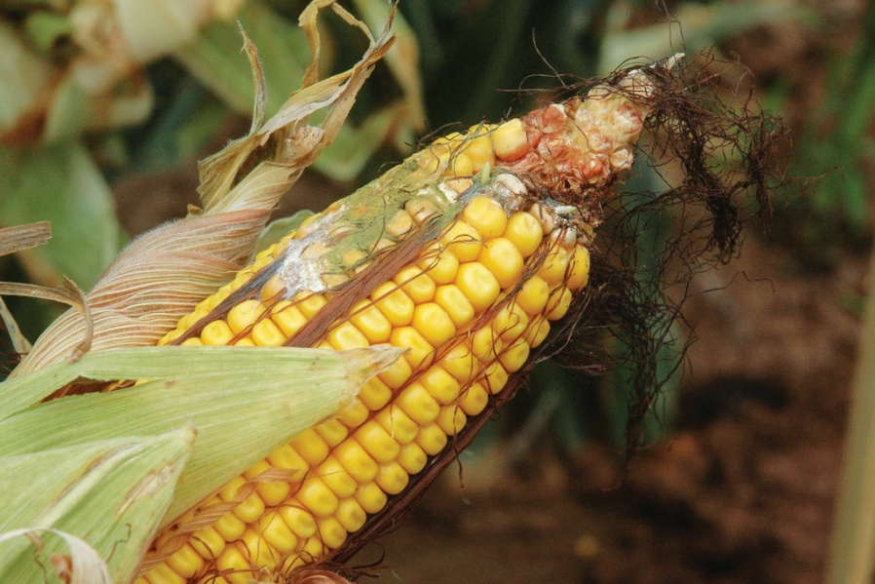
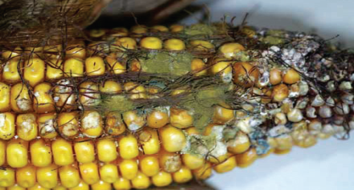
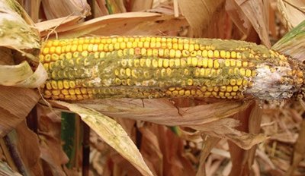
Aflatoxin
The weather and growing conditions can increase the possibility of Aflatoxin in some corn fields. Your crop insurance policy provides coverage for Aflatoxin.
Grain Stored On The Farm
Samples must be pulled directly from each field by an adjuster. SAMPLES CANNOT BE PULLED FROM THE BIN.
Samples are sent to a certified lab. The insured is responsible for the cost (ranges from $25-30 per sample).
If Aflatoxin levels are present, the production from the field will be adjusted according to the discount factor chart shown on next page.

Slide 20
Aflatoxin
Discount Factor Chart (parts per billion)
Level | Discount
0 – 20 | 0
20.1 – 50 | 10%
50.1 – 100 | 20%
100.1 – 200 | 30%
200.1 – 300 | 40%
300.1 – up | Call your FCS Agent
Grain Delivered To The Elevator
Elevators actively check loads for Aflatoxin levels.
If Aflatoxin is found:
Samples are pulled directly from each field by an adjuster. If the elevator pulls a sample out of the truck and keeps it separate, it can be picked up by the adjuster.
Samples are sent to a certified lab. The insured is responsible for the cost (ranges from $25 - $30 per sample).
If Aflatoxin levels are present, one of these two discount procedures will be used:
“DF” – discount factor (see chart) applies to UNSOLD GRAIN.
“RIV” – reduction in value. This directly relates to the discount the elevator applies to your SOLD GRAIN. (Ex: Market price is $8.00.
Elevator pays $6.00 (= 25% reduction) NOTE: The insured has until February 8, 2013 to sell grain in commercial storage to use RIV discount; otherwise DF is used.
If a load of grain is rejected by the elevator, explore other options for deliver and call your agent.

Slide 21
Harvest Claim Information
HARVEST – Proceed with normal harvesting operations unless you plan to do something else with the crop besides harvest (chop silage, destroy crop, etc.).
$200K REVIEW – If any claim (per crop, per county) exceeds $200K, a 3-year APH audit of the policy will be conducted. Call your FCS agent prior to gathering records (load summary sheets from elevator are most common).
GRAIN BINS – If storing grain:
Old crop left in bins must be measured by adjustor prior to adding new crop.
Keep load records and mark bins with tape if co-mingling farm/fields.
HARVEST CLAIM – Will be processed when you complete harvest.
If delivered to elevator, have delivery sheets ready from elevator (bins will be measured)
Decide which tax year (current or succeeding) you will want your claim check.
Consult with a tax advisor on how income deferment can be handled.

Slide 22
Thank You!
Lee Waters
lee.waters@fcsillinois.com
Errol Maul
errol.maul@fcsillinois.com
217-590-2222

